Slide 1

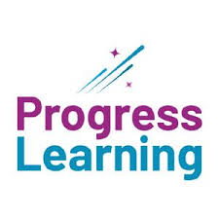
Analyzing Learning Journeys and Tracking Progress
BY
RICHARD AKINWARE

Slide 2

“
Analyzing Learning Journeys and Tracking Progress provides invaluable insights into the educational process, allowing us to understand how individuals navigate and engage with learning materials. By examining various metrics such as Purchase Reference, Access, Lectures Completed, No of Lectures, Percentage Completed, Certificate Attainment, and Date Joined, we gain a comprehensive understanding of each learner's progress.
This approach enables educators and organizations to optimize learning experiences, identify areas for improvement, and ultimately enhance learning outcomes."
INTRODUCTION

Slide 3
PROCESS WORKFLOW
1.Collecting and preparing dataset
2.Cleaning and Transformation of data
3. Analysis And visualization
4. Limitation
5. Recommendation

Slide 4
PROBLEM STATEMENT
Despite advancements in educational technology and online learning platforms, there remains a challenge in effectively analyzing learning journeys and tracking progress.
Without a comprehensive understanding of how individuals engage with learning materials and progress through courses, educators and organizations struggle to optimize learning experiences and enhance outcomes.
This problem statement highlights the need for robust analytical frameworks and tools to accurately assess metrics such as Purchase Reference, Access, Lectures Completed, No of Lectures, Percentage Completed, Certificate Attainment, and Date Joined. Addressing this challenge is crucial for improving educational effectiveness and promoting lifelong learning.

Slide 5
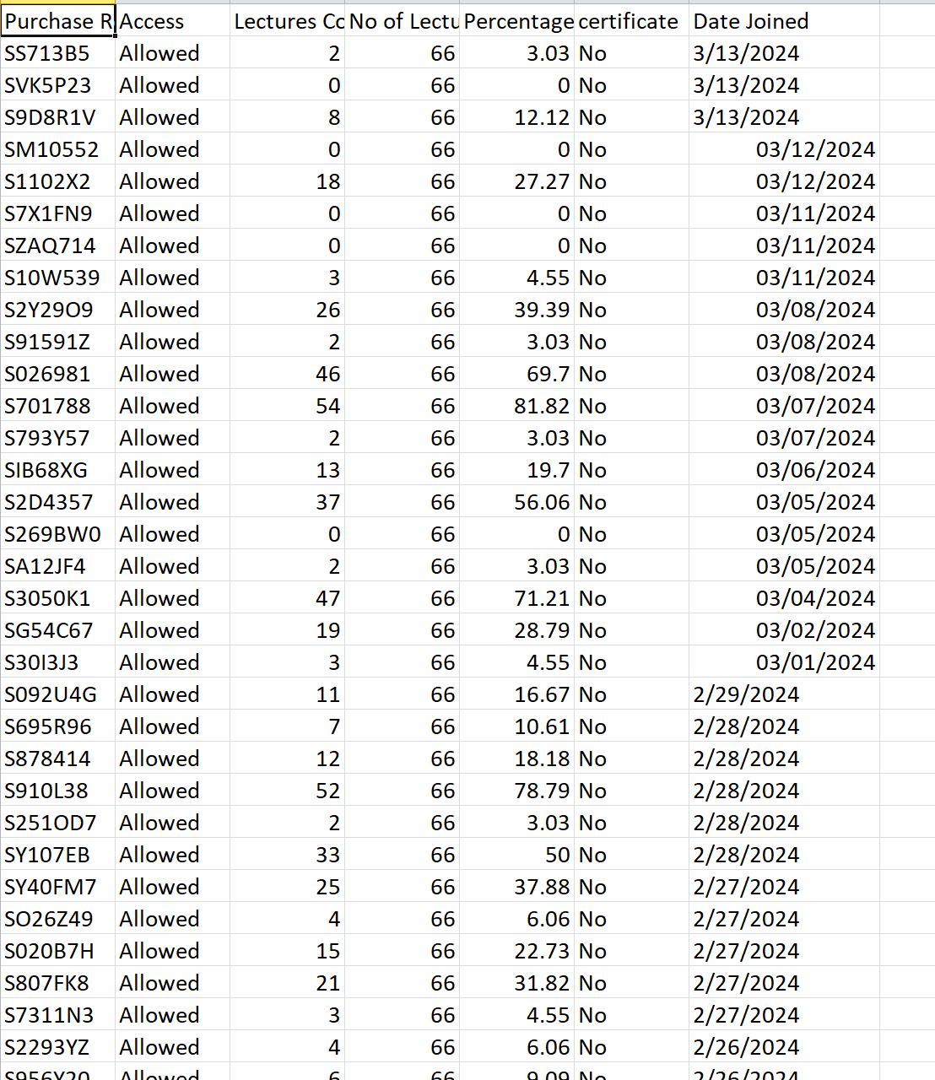
UNCLEAN DATA

Slide 6
Data Cleaning Process
Remove duplicate
Reformat column
Sort and fitter column alphabetically
Remove Incorrect data and empty space

Slide 7
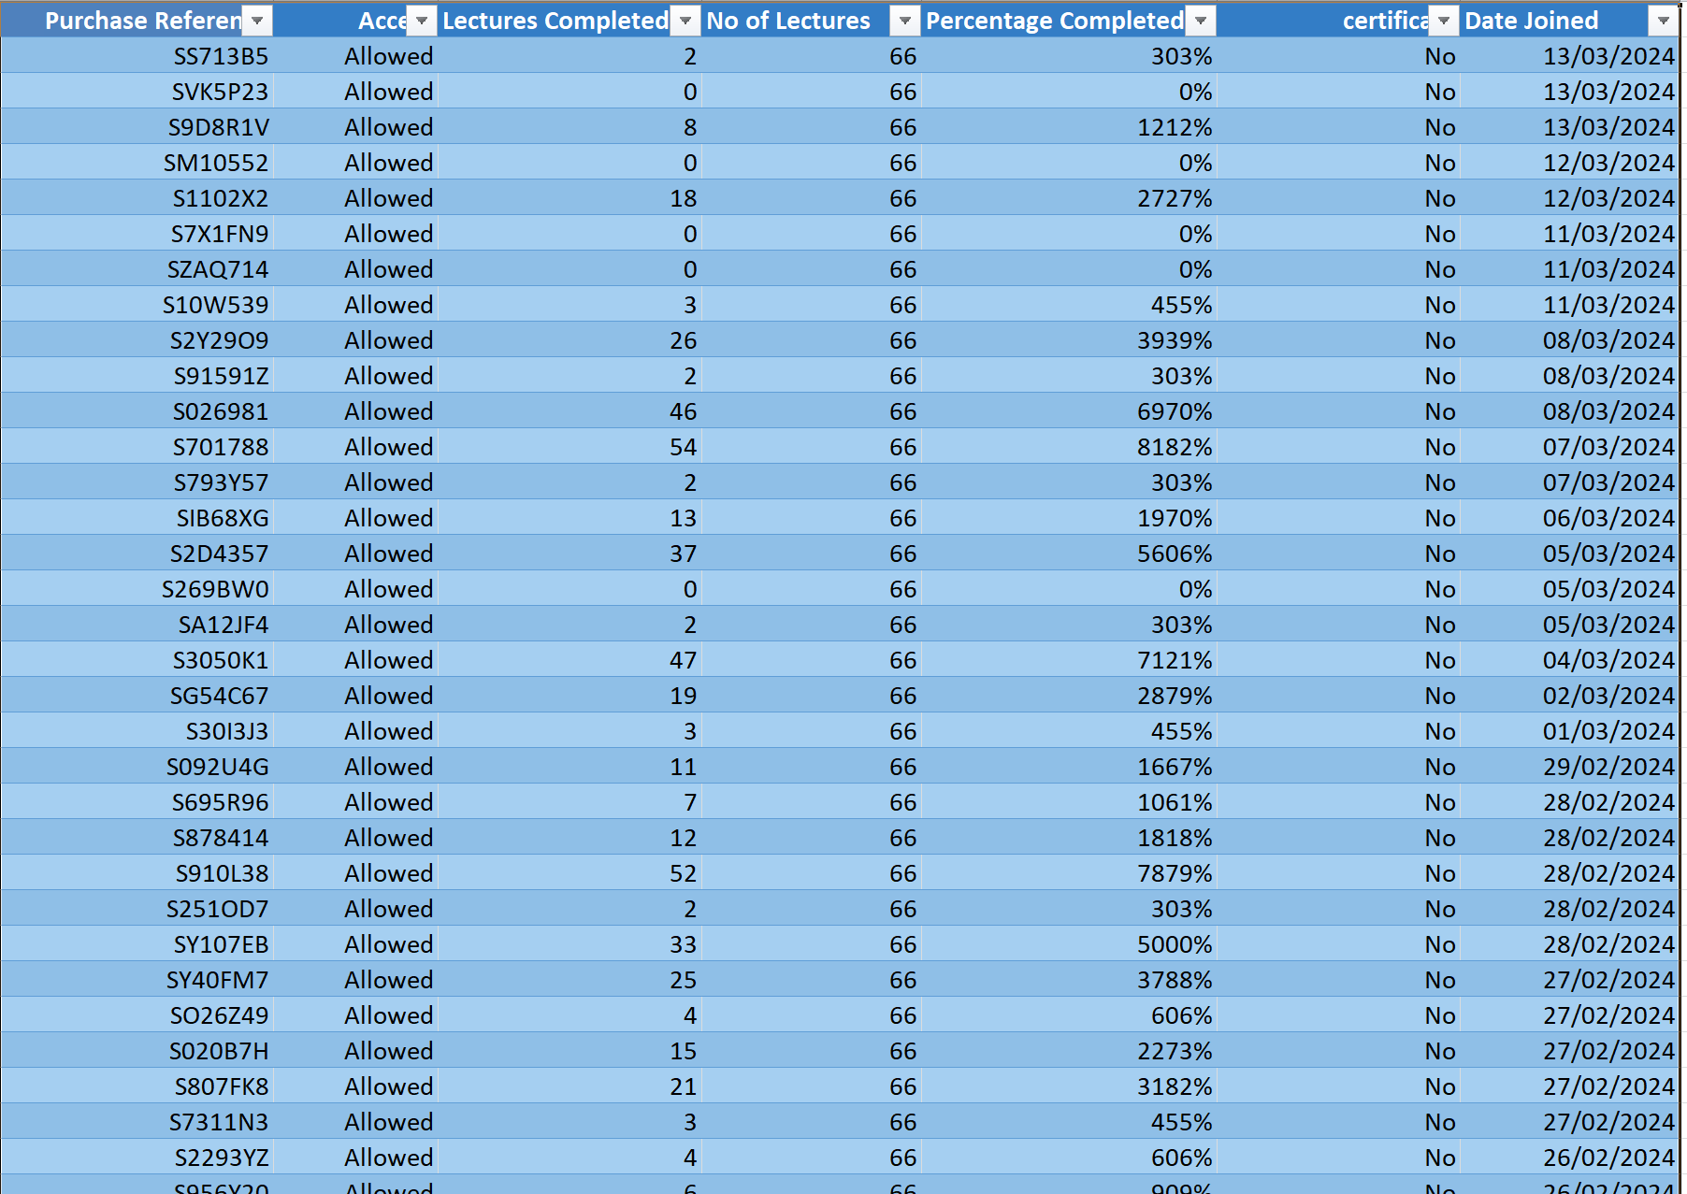
Clean Data

Slide 8
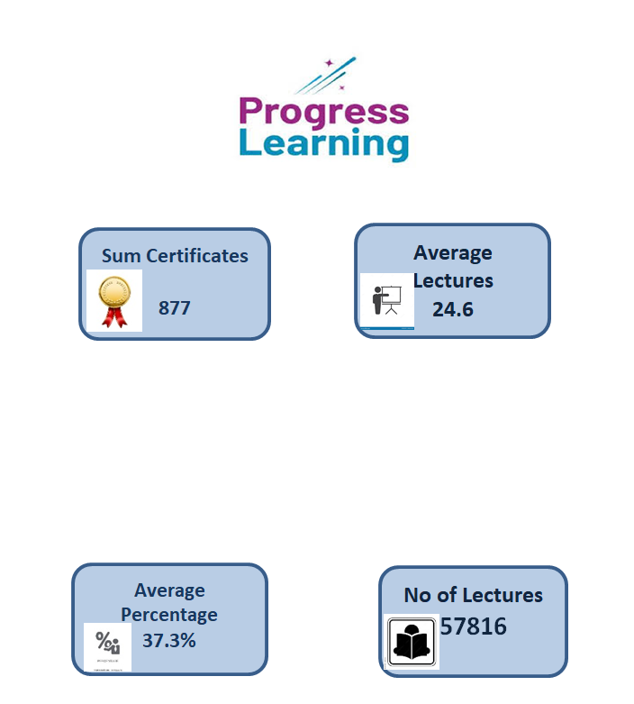
INSIGHT AND ANALYSIS

Slide 9
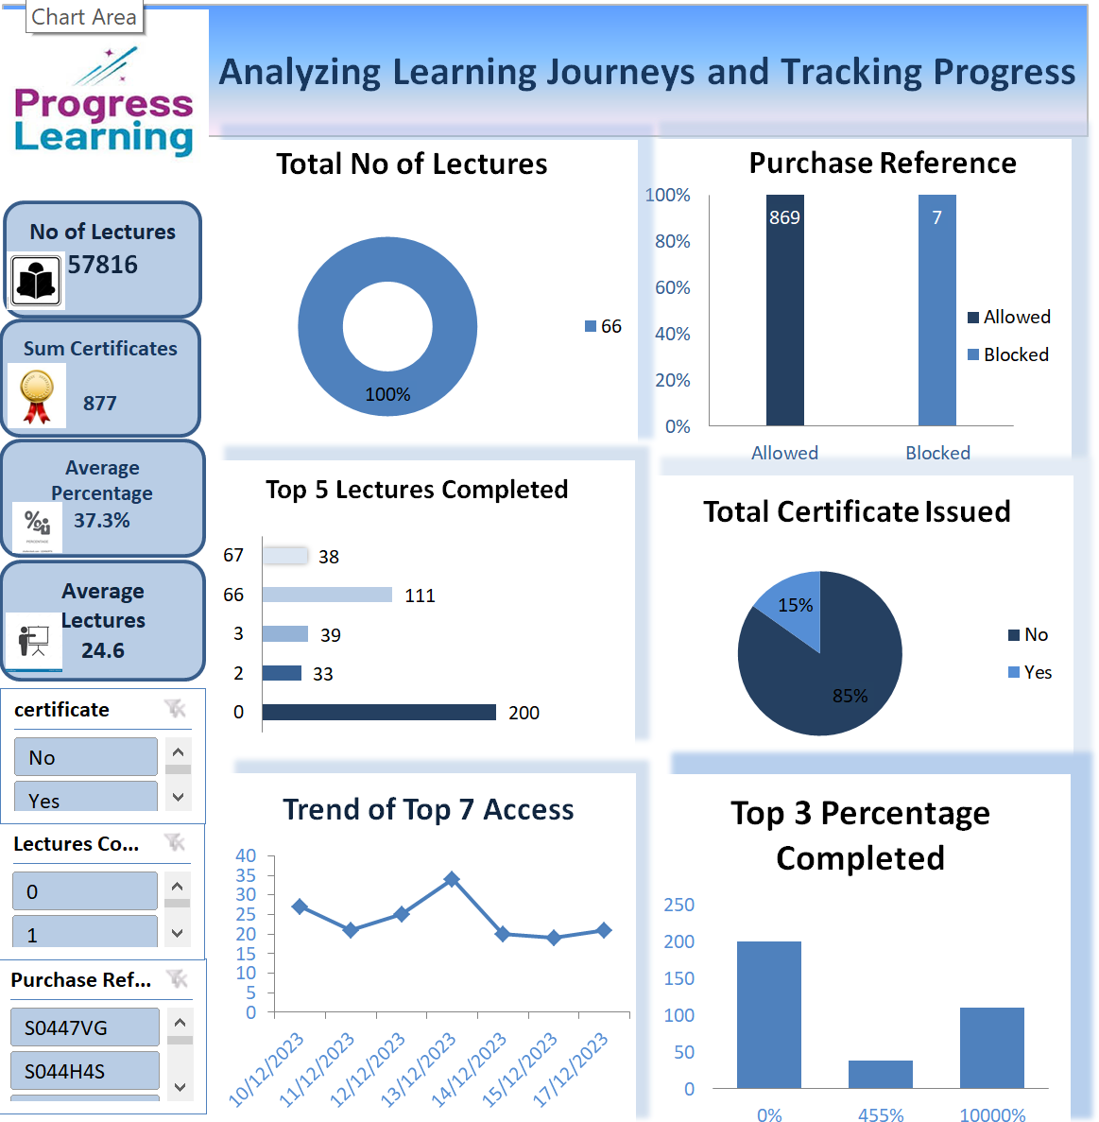
DATA VISUALIZATION

Slide 10
Limitation
limitation in analyzing learning journeys and tracking progress is the potential for incomplete or inaccurate data, which can lead to gaps in understanding learner behavior and outcomes.
Additionally, relying solely on quantitative metrics may overlook the qualitative aspects of learning experiences, such as engagement and motivation. Privacy concerns and ethical considerations surrounding data collection and usage also pose challenges. Lastly, contextual factors like socio-economic background and learning styles may not be fully captured by standard metrics, necessitating a more holistic approach to analysis.

Slide 11
Recommendation
Implement robust data collection and analysis procedures: Ensure accurate and consistent data collection methods across educational platforms, and use advanced analytics techniques to derive meaningful insights from the data.
Prioritize learner privacy and data protection: Adhere to strict privacy guidelines and ethical standards when collecting and analyzing learner data, ensuring transparency and consent throughout the process.
Customize learning experiences based on insights: Use the findings from data analysis to tailor learning materials and experiences to meet the diverse needs and preferences of learners.

Slide 12
Conclusion
In conclusion, analyzing learning journeys and tracking progress is essential for optimizing educational outcomes. By understanding how learners engage with course materials and progress through their learning journey, educators can tailor interventions and resources to meet individual needs.
While challenges such as data accuracy and privacy concerns exist, leveraging insights from tracking progress enables educators to create more personalized and effective learning experiences.
Continuous evaluation and refinement of tracking methods are necessary to adapt to changing educational landscapes and ensure ongoing improvement in student outcomes.

Slide 13


